Slide 1

CAPSTONE PROJECT
Title : Light Sensor Interfacing With PWM Output LED
Presented by group 01:
Gagandeep
Hrishikesh
Pranav R K
Vinay raj B

Slide 2
Problem statement
Light Sensor Interfacing With PWM Output LED:
1.Estimate the ambient light level and set it as a base level.
2.Using the LDR (light dependent resistor) as a light sensor to sense the ambient light intensity.
3.Map light intensity to a PWM duty cycle and get this signal out on an LED.
4.The LED brightness increases as the surrounding gets darker.

Slide 3


Requirements
Hardware requirements:
STM32 Nucleo-64
Arduino Sensor Kit
Logic analyzer
Software requirements:
STM32CubeIDE 1.13.1
Logic 2.4.9

Slide 4
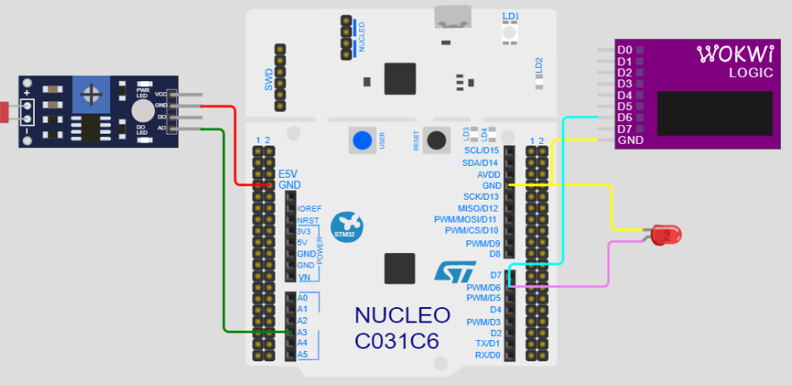
BLOCKDIAGRAM

Slide 5
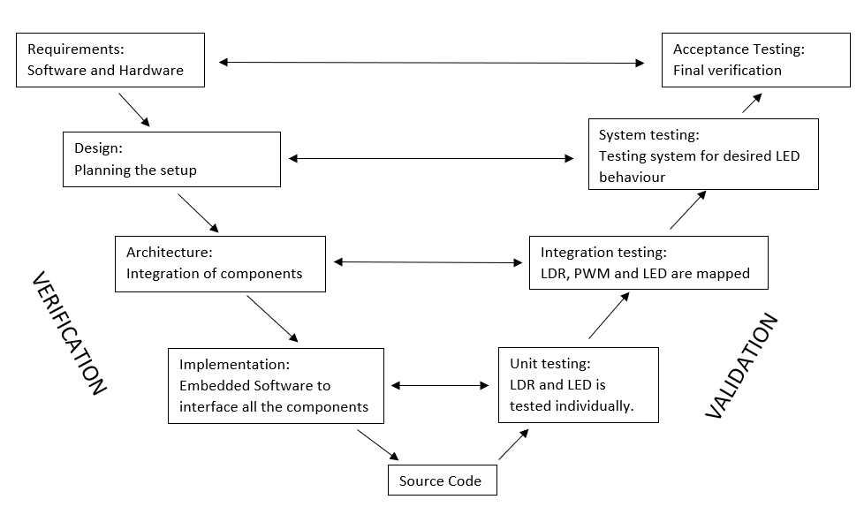
Implementation
Figure : V–model implementation

Slide 6
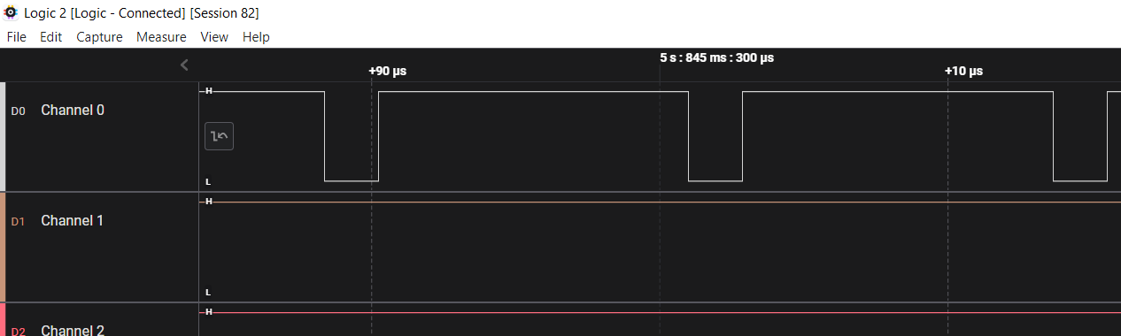
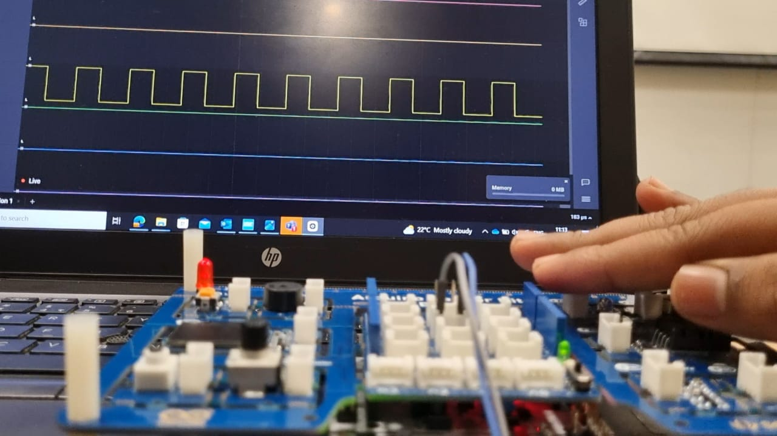
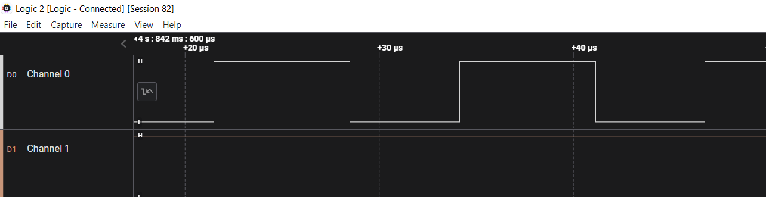
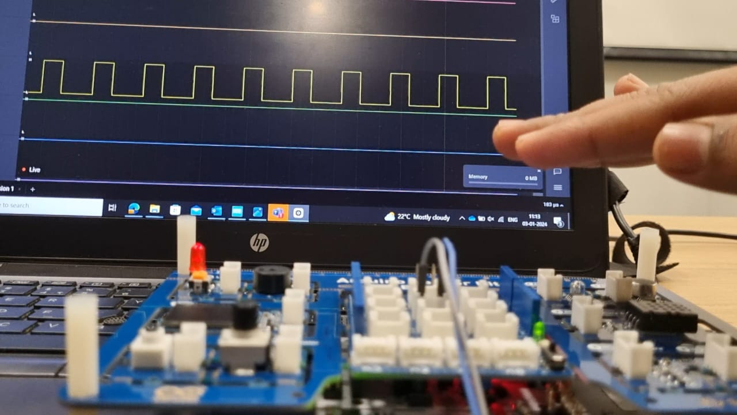
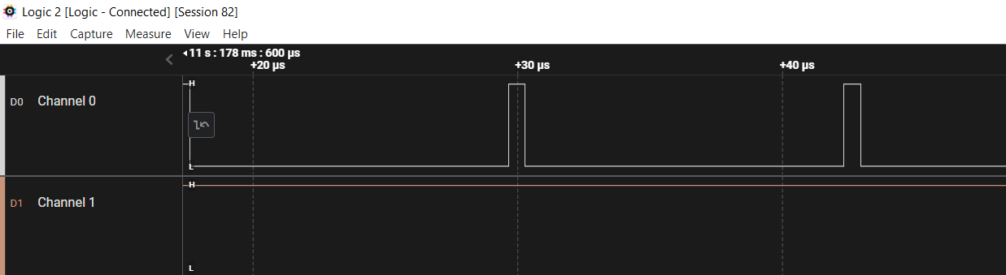
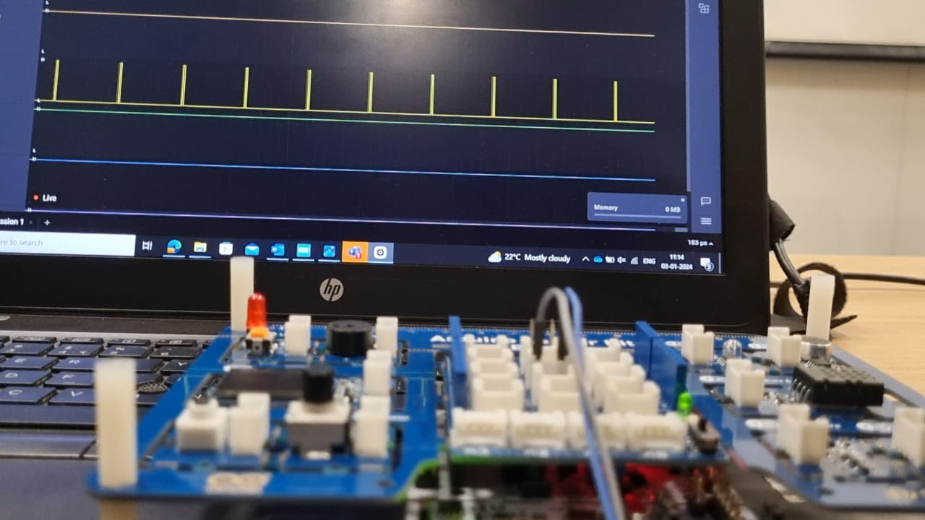
Result
85% duty cycle
55% duty cycle
4% duty cycle

Slide 7
Conclusion
Analog to Digital Conversion: Learning how to interface with analog sensors, convert their output to digital values, and read those values using an ADC
PWM Control: Implementing PWM (Pulse Width Modulation) to control the brightness of an LED by mapping the light intensity measured by the LDR to a PWM duty cycle.
Project Lifecycle: Understanding how the V-Model and testing methodology can be applied to manage and correlate project phases and testing phases effectively

Slide 8
THANK YOU

